Slide 1
DEMOCRACY
IT IS BASED ON EQUALITY AND FREEDOM, SO EVERYBODY SHOULD HAVE THE SAME RIGHTS.

Slide 2
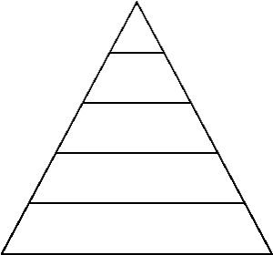
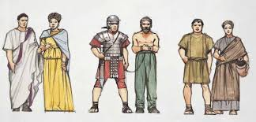
DID DEMOCRACY REALLY EXIST IN ANCIENT ROME?
No, because there weren’t the same rights for everyone.
Patricians
Knights
Plebeians
Slaves

Slide 3
SOCIAL SITUATION
Patricians
Plebians
Slaves
(speaking objects)
They were excluded from most political rights but they were represented by TRIBUNS OF PLEBS
They didn’t have any civil rights and they were treated as objects, in fact the slave was called instrumentum semivocale
They were rich and they had privileges.

Slide 4
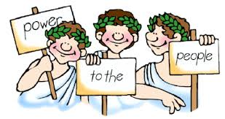
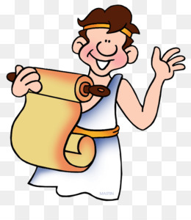
SOME LATIN WRITERS MADE ROMAN PEOPLE THINK ABOUT SOME DEMOCRATIC VALUES SUCH AS : - TOLERANCE - HUMAN KINDNESS - RESPECT - FREEDOM OF SPEECH AND OF THOUGHT .
The so called HUMANITAS

